Slide 1
APACHE SPARK
by Priti Bhardwaj , CDAC NOIDA, India

Slide 2

Real Time Analytics

Slide 3
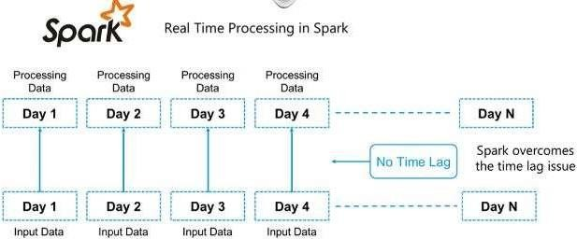
Why Spark when Hadoop is already there?

Slide 4
What is Spark?
Apache Spark is an open source cluster computing framework for real-time data processing.
Main feature of Apache Spark : in-memory cluster computing that increases the processing speed of an application.
Spark provides an interface for programming entire clusters with implicit data parallelism and fault tolerance.

Slide 5
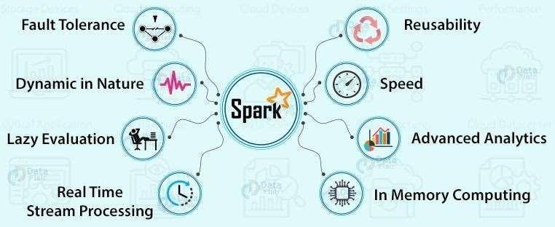
Features of Apache Spark

Slide 6
Spark Components
Spark
SQL
Spark Streaming
Spark
MLlib
GraphX
SparkR
Apache Spark Core API

Slide 7
Resilient Distributed Dataset(RDD)
RDDs are the building blocks of any Spark application. RDDs Stands for:
Resilient: Fault tolerant and is capable of rebuilding data on failure
Distributed: Distributed data among the multiple nodes in a cluster
Dataset: Collection of partitioned data with values

Slide 8
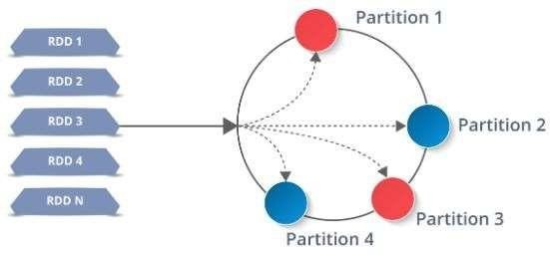
Resilient Distributed Dataset(RDD)

Slide 9
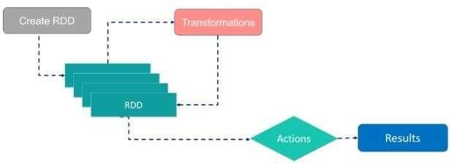
Resilient Distributed Dataset(RDD)

Slide 10
Resilient Distributed Dataset(RDD)
Two types of operations:
Transformations: They are the operations that are applied to create a new RDD.
Actions: They are applied on an RDD to instruct Apache Spark to apply computation and pass the result back to the driver.

Slide 11
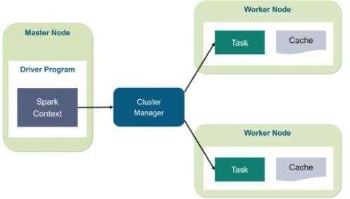
Working of Spark Architecture

Slide 12
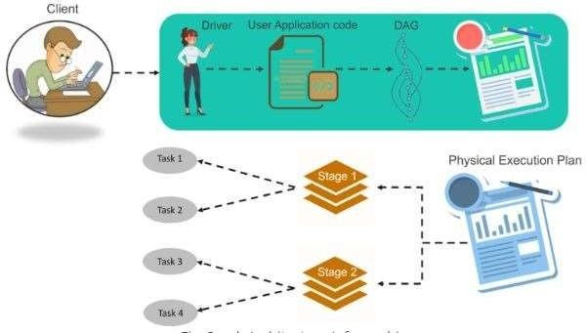
Working of Spark Architecture

Slide 13
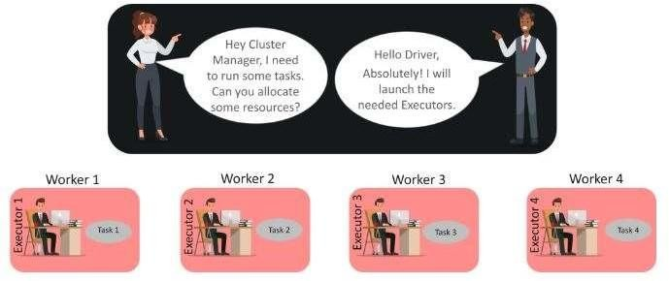
Working of Spark Architecture

Slide 14
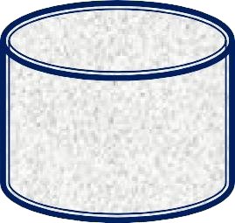
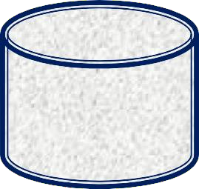
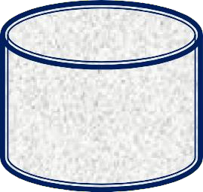







Iterative Operations on Hadoop MapReduce and on Spark RDDs
Read
Write
Read
Write
Stable
storage HDFS
Job 1
Stable
storage HDFS
Job 2
Stable
storage HDFS
Read
Write
Read
Write
Stable storage HDFS
Job 1
Memory
Job 2
Stable storage HDFS

Slide 15

















Interactive Operations on Hadoop MapReduce
HDFS Reads
Query 1
Result 1
Input from Stable Storage
Query 2
Result 2
Query 3
Result 3

Slide 16














Interactive Operations on Spark RDDs
Query 1
Result 1
Input from Stable Storage
HDFS Reads
Distributed
Query 2
Result 2
Result 3
One Time Processing
Memory
Query 3

Slide 17

RDD are the building blocks of any spark application.
Resilient: Fault tolerant and capable of rebuilding data on failure.
Distributed: Distributed data among the multiple nodes in acluster.
Dataset: Collection of partitioned data with values.
Each dataset in RDD is divided into logical partitions.

Slide 18








Partition1
Partition2
RDD
…………….
Partition n

Slide 19






Spark RDD Features
In-memory Computation
Fault Tolerant
Immutability
Partitioning

Slide 20

Create RDD
Transformations
RDD
Actions
Results

Slide 21




Spark paired RDDs Creation
Parallelizing collection (Parallelize)
Referencing External
Dataset
Creating RDD from existing RDD

Slide 22
Spark SQL
Spark module for structured data processing
DataFrame API and Datasets API
Spark SQL runs on top of the spark core.

Slide 23

Features of Spark SQL
Integrated
Unified data access
Features
High compatibility
Standard connectivity
Scalability
Performance optimization

Slide 24


Spark SQL Architecture
DataFrame DSL
Spark SQL and HQL
DataFrame
DataSource
CSV
JSON
JDBC

Slide 25
SQL Context
SQLContext is a class used to initialize functionalities of Spark SQL
An entry point to Spark SQL
SparkContext object sc is required for initializing SQLContext class.
val sqlcontext = new org.apache .spark.sql .SQL Context( sc)

Slide 26
DataFrame
A distributed collection of data, which is organized into named columns
A DataFrame can be constructed from an array of different sources such as Hive tables, Structured Data files, external databases, or existing RDDs.

Slide 27

Features of DataFrames
Ability to process data in size of KB to PB.
Different data formats and storage systems
Features
Integration with big data tools and frameworks
API for Python, Java ,Scala and R programming
Distributed, lazy evaluation and Immutable

Slide 28
Create DataFrame
createDataFrame()
toDF()
Existing RDD, DataFrame, Dataset, List, Seq data objects
Sources like Text,CSV,JSON,XML, Binary files, RDBMS Tables, Hive

Slide 29




Different Types of DataSources
DataSources
JSON Datasets
HIVE Tables
Parquet Files

Slide 30
Spark MLib
Spark MLlib is used to perform machine learning in Apache Spark
spark.mllib : original API built on top of RDDs
spark.ml
:higher level API built on top of DataFrames.

Slide 31

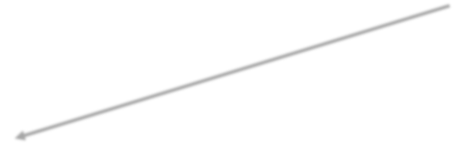
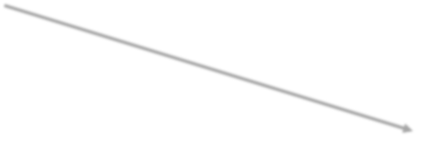








Algorithms and Utilities in Spark MLib
Mlib Algorithms
Basic Statistics
Classification
and Regression
Dimensionali
ty Reduction
Feature
Extraction
Clustering

Slide 32







Spark Mlib Tools
Spark Mlib Tools
ML
Algorithms
Featurization
Pipelines
Persistence
Utilities

Slide 33
THANK YOU

